Slide 1
Excel Plotting
Lesson 1.3

Slide 3
We are off to the races!

Slide 4

This will be you at the end of class.

Slide 5
Adding Files to Github

Slide 6




GitHub Is a Hosting Service for Source Code
GitHub is a web interface for Git.
Git is version control software that can:
Track source code history
Allow for collaboration on the same code files across a team or organization
Easily update and roll back software versions
GitHub is used by over 4 million organizations.
Proficiency in Git and GitHub are highly desired skills in many industries.

Slide 7
Git and Github
We will use Git and Github throughout the curriculum
You will submit your homework assignments using Github.
Your individual project work will be version controlled using Git.
You will be collaborating with teammates using Github.
By the end of the curriculum, you should be proficient with the basic Git and Github functionality.

Slide 9
Basic Charting

Slide 10
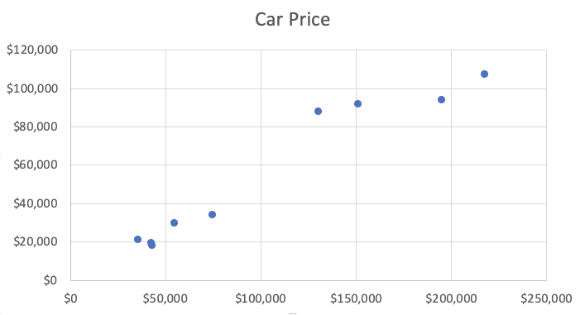
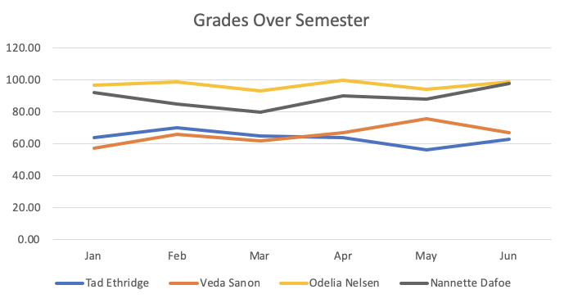
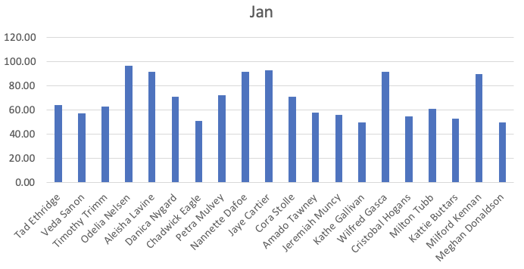
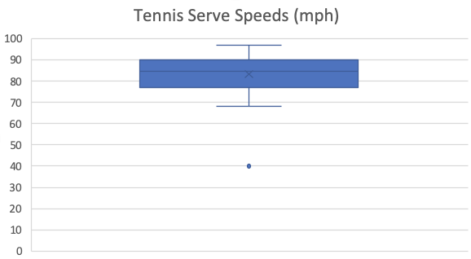
It is time to learn Excel visualizations!

Slide 11
We will look at a few examples and use cases
In this activity, we will:
Look at an example data set
Select data of interest
Visualize selected data
Add labels and titles to our visualization
Do not hesitate to ask questions. Our TAs will slack out images for each operating system

Slide 13
Activity: The Line and Bar Grades
For this activity, you’ll take on the role of the teacher as you create bar and line graphs to visualize your class’s grades over a semester.
15 minutes

Slide 14
Activity: Line and Bar Grades
For this activity, you’ll take on the role of the teacher as you create bar and line graphs to visualize your class’s grades over a semester.
Instructions: | Hint:
Create a series of bar graphs that visualize the grades of all students in the class, with one graph for every month. Create a line graph using all of the data that can be used to compare students' grades across the semester. Use filtering in the line graph to allow you to drill down to a specific student's progress throughout the semester. | When duplicating bar graphs, it pays to get the formatting and look of the chart where you want it for the first graph (e.g., for January), and to then copy that chart and re-select the data for the subsequent copies (keeping the style and format, but just changing the data).

Slide 16
Scatter Plots and Trend Lines

Slide 17
Scatter plots are a powerful visualization tool!
Visualizes the comparison between two variables:
One variable | is located on the x-axis
Another variable | is plotted on the y-axis
Mouse weight (g)
Each data point represents a pair of measurements
Measurements on a scatter plot are independent
Scatter plots can help to identify positive or negative relationships between two variables
Adding a trend line to a scatterplot can visualize this relationship even easier!
35
30
25
20
15
10
5
Mouse weight (g)
2 2.2 2.4 2.6 2.8 3 3.2 3.4 3.6 3.8
Mouse length (inches)

Slide 19
Partner Activity: Home Sales
For this activity, you will work in pairs to create a series of scatter plots that compare home prices in the St. Louis, MO, region.
15 minutes

Slide 20
Partner Activity: Home Sales
Instructions:
Create a scatter plot that compares the price of the home with the square feet of the home (`sqft_living`). Make sure to add in axis titles, a chart title, and a trend line.
Create a scatter plot that compares the price of the home with the number of bedrooms. Make sure to add in axis titles, a chart title, and a trend line.
Create a scatter plot that compares the price of the home with the number of bathrooms. Make sure to add in axis titles, a chart title, and a trend line.
Go back into each of your charts, and modify the value range on each axis so that they are consistent across charts.
We want the axes to match so the data is conveyed in a consistent, truthful manner.

Slide 22
The Need to Filter

Slide 23
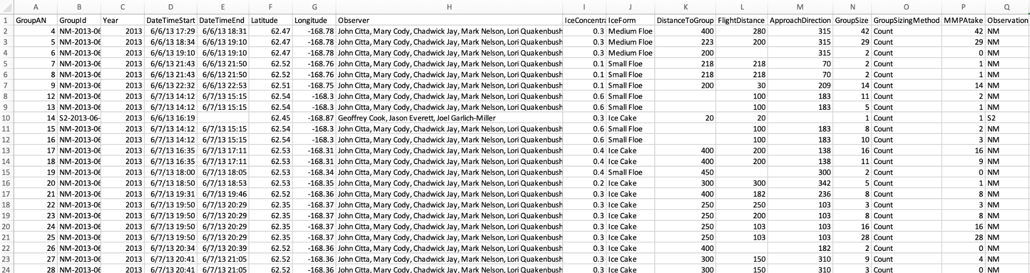
Do you notice anything about the following data?

Slide 24
There is a LOT of missing and unneeded data
Most data sets contain multiple variables and factors
It can be difficult to determine what data is useful when exploring a data set
It can be hard to locate data of interest
We need to filter our data

Slide 26
Partner Activity: Filtering Home Sales
For this activity, you'll create a filtered chart that visualizes increases in waterfront properties over time in the St. Louis Area.
15 minutes

Slide 27
Partner Activity: Filtering Home Sales
In this activity, you will pair up with one of your classmates in order to create a filtered chart that visualizes increases in waterfront properties over time in the St. Louis Area.
Instructions:
Use the St. Louis Home Sales Dataset provided.
Examine the data and check out the available columns.
Create a line graph that shows the price trend of waterfront homes in St. Louis by the age of the home.

Slide 30
Variance, Standard Deviation and Z-Score

Slide 31
Quick Refresher

Slide 32
What are the three measures of central tendency?

Slide 33
The mean, median and mode.
The mean, median and mode.
Mode Mean Median
Mode
Mode
Median
Median
Mean
Mean
Left Skew
Normal Distribution
Right Skew

Slide 34
What are the measures of central tendency used for?

Slide 35

A
Metrics used to describe the center of a data set.

Slide 36
How do you describe
the variability of a data set?

Slide 37
Variability of a Data Set
Three summary statistics metrics for describing variability:
01
Variance
02
Standard Deviation
03
Z-Score

Slide 38
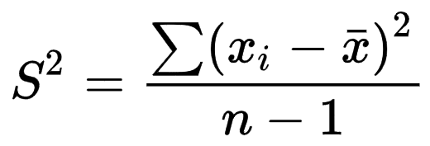
Variance
Used to describe how far values in the data set are from the mean
Describes how much variation exists in the data
Variance considers the distance of each value in the data set from the center of the data
The value of the one observation
The mean value of all observations
Sample variance
The number of observations

Slide 40
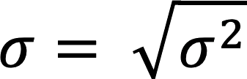
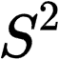
Standard Deviation
Describes how spread out the data is from the mean
Calculated from the square root of the variance
In the same units of measurement as the mean
The variance
Standard deviation

Slide 41
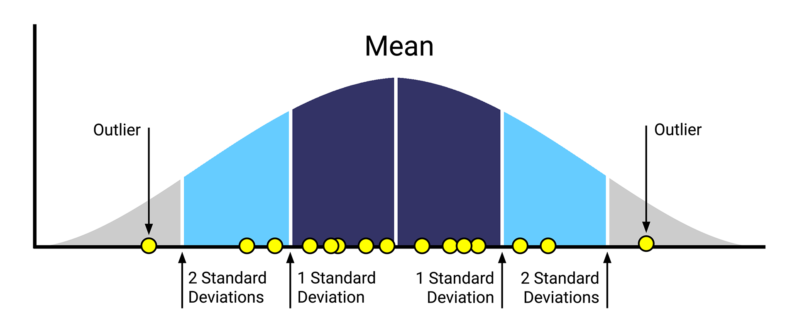
Standard Deviation
Square root of the variance; a measure used to quantify the dispersion of a set of observations.

Slide 42
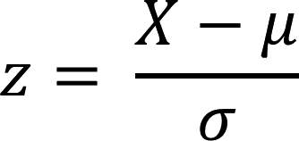
Z-Score
Z-Score describes a single value’s distance from the mean of the data set
The distance is in terms of standard deviations. Can be positive or negative:
If negative | the value is less than the mean
If positive | the value is greater than the mean.
The smaller the z-score, the closer the value is to the mean
A single value
The mean of the dataset
The standard deviation of the dataset

Slide 44
Activity: Variance, Standard Deviation, and Z-Score Review
It is now your turn to practice summarizing the variability of a data set using heart disease death rate data from the CDC.
15 minutes

Slide 45
Activity: Variance, Standard Deviation, and Z-Score Review
Open the variance_review.xlsx workbook that contains your raw data Then clean up the dataset as follows:
Rename the Data_Value column to Death Rate Per 100,000.
This column contains missing data, so add a filter to the column that displays all rows except (blanks).
Rename the Stratification1 and Stratification2 columns to Gender and Race/Ethnicity, respectively.
Rename LocationAbbr to State.
Filter the GeographicLevel column so that State and county values are not compared together.
Create a new sheet in the workbook named Summary Table that has a State column containing the following values: AR - Arkansas , CA - California, FL - Florida, ME - Maine, MS - Mississippi, OR - Oregon
For each state, determine the mean, variance, and standard deviation for the overall death rate.
Based on your calculated summary statistics determine which state had the greatest difference in death rate across all its counties and which state had the lowest variance in death rate. What was the death rate?
Create a new sheet in the workbook named Oregon Z-Scores. Within this new sheet, copy over the LocationDesc (renamed to County) and Death Rate Per 100,000 columns from the raw data for only the state OR where Gender is Overall.
Calculate the z-score for the overall death rate by county across the whole state and use those values to determine which county had the largest difference in death rate from the mean of the state.
Based upon your calculated z-scores, determine which county had the largest difference in death rate from the mean of the state.

Slide 47
Quantiles, Outliers and Boxplots

Slide 48
Real-World Data
Be careful when describing real-world data:
Real world data can contain extreme values
Some summary statistics such as the mean take into account all values of a data set
Extreme values can skew these statistics!

Slide 49
But how can we summarize real-world data?

Slide 50

Quantiles: Used to Describe Segments of a Dataset
Quantiles separate a sorted dataset into equally sized fragments.
The two most popular types of quantiles are and .
quartiles
percentiles
01
Quartiles divide the dataset into four equally sized parts.
02
Percentiles divide the dataset into 100 equally sized parts.
10 | 20 | 30 | 40 | 50 | 60 | 70 | 80 | 90 | 100
Part 1
Part 1
Part 1
Part 1

Slide 52
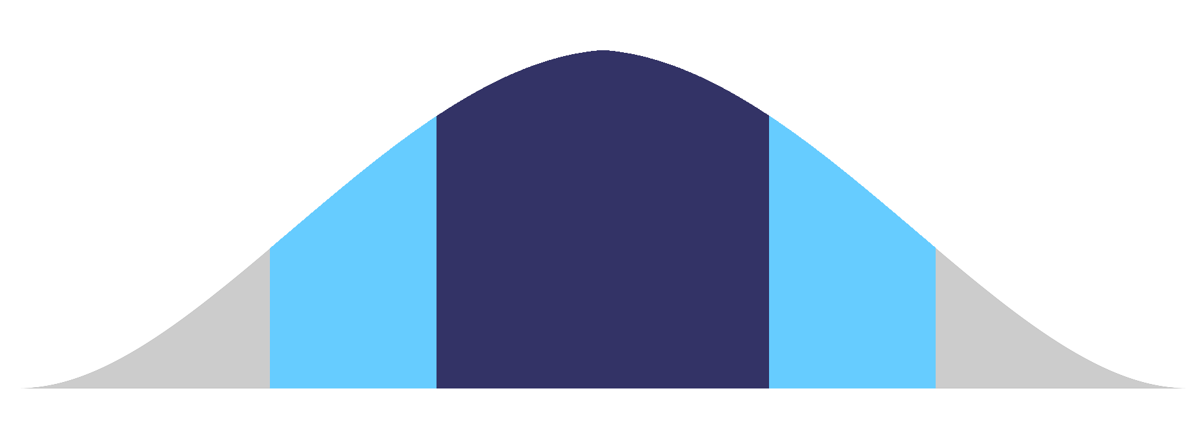
Outliers
Suspicious values are called potential outliers. An outlier is a data point that differs from the rest of a data set. Outliers can inaccurately skew a data set.
Mean
Outlier
Outlier
3 Standard Deviations
2 Standard Deviations
1 Standard Deviation
1 Standard Deviation
2 Standard Deviations
3 Standard Deviations

Slide 53
Qualitatively
Use box-and-whisker plots to visually identify potential outliers.
# Create box plot
plt.boxplot(arr, showmeans=True
plt.grid()
plt.show()
25
20
15
10
5
Upper whisker
Upper quartile
Median
Outlier
Lower quartile
Mean
Lower whisker
1

Slide 54
Quantitatively
Determine the outlier boundaries in a dataset by using the 1.5 ⨉ IQR rule.
The IQR is the range between
the first and the third quartile.
Anything less than, or below, Quartile 1 — (1.5 ⨉ IQR)
might be an outlier.
Anything greater than, or above, Quartile 3 + (1.5 ⨉ IQR)
might be an outlier.
25
20
15
10
5
1

Slide 55
Activity: Cereal Outliers
In this activity, you will be investigating data from a dataset called 80 Cereals. Your task is to search through the ratings of each product and determine if there are any potential outliers in the dataset.
10 minutes

Slide 56
Activity: Cereal Outliers
Instructions:
Open up the activity workbook, and familiarize yourself with the raw data.
File: Unsolved/Outliers_Activity_Unsolved.xlsx
Create a new worksheet, and name it "Outlier Testing".
In the "Outlier Testing" worksheet, create a summary statistics table of the Antioxidant_content_in_mmol_100g for the following statistics:
Mean
Median
Minimum value
Maximum value
First quartile
Third quartile
Interquartile Range
Using the calculations from the table, determine the lower and upper boundaries of the 1.5*IQR rule.
Determine if there are any products whose Antioxidant_content_in_mmol_100g falls outside of the 1.5*IQR boundaries. List those products and their antioxidant content on the worksheet.
Create a box plot of the Antioxidant_content_in_mmol_100g for all products.
Note: Be sure to add a title, and label your y-axis.

Slide 58
Excel’s Statistics Add-On

Slide 59

Excel is a great foundational tool

Slide 60
Up to this point we have only covered summary statistics...

Slide 61
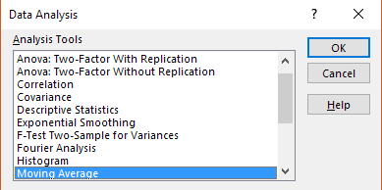
But Excel can be used for even MORE statistics!
The Excel Analysis ToolPak contains:
T-tests
Correlation Tests
Regression Tests
ANOVA
All of these functions we will cover throughout the course!

Slide 62
Analysis ToolPak is not designed for in-depth data analytics
Excel struggles with medium to large data sets:
>200 columns or >100000 rows
Depends on machine
Excel does not automatically record parameters for statistical tests
Excel’s Analysis ToolPak should be used
Gut-checks
One-off analysis

Slide 63
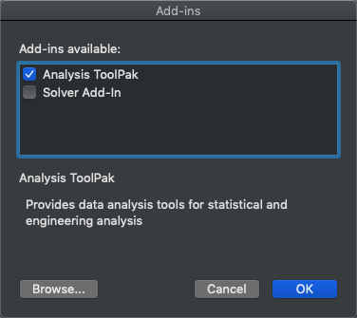
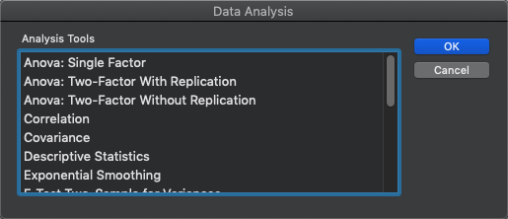
How to install and use the Excel Analysis ToolPak: Mac
To Install:
01
Go to the “Tools” menu in Excel.
02
Select the “Excel Add-Ins…” option.
03
Enable the “Analysis ToolPak” option.
04
Press “OK”.
To Use:
01
Go to the “Data” menu in Excel.
02
Select the “Data Analysis” option.

Slide 64
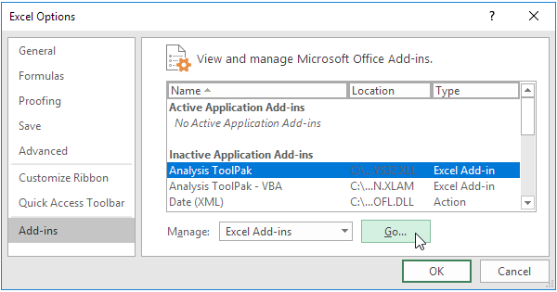
How to install and use the Excel Analysis ToolPak: PC
To Install:
01
Click the File tab
02
Go to Options
03
Select the Add-Ins category
04
In the Manage box, select Excel Add-ins and click Go
05
In the Add-Ins box, enable the Analysis ToolPak and click OK.
To Use:
01
Go to the “Data” menu in Excel.
02
Go to the “Analyze” section.
03
Select the “Data Analysis” option.

Slide 66
Who feels comfortable with plotting figures in Excel?

Slide 67
Who feels comfortable calculating summary statistics in Excel?

